Slide 1
Introduction to Computation
Fan Cheng Shanghai Jiao Tong University
http://www.cs.sjtu.edu.cn/~chengfan/
chengfan@sjtu.edu.cn
Autumn, 2022
Notes:
Numbers, floating numbers, string, mathematical expressions, print()

Slide 2
Outline
Review of Past Lectures
Practice problems

Slide 3
Programming language
In principle, all the popular PLs have the following elements:
Input and output:
input(), print()
Types and variables
type(), id(), int(), float(), str(), chr(), ord()
Basic expressions: logic, mathematics
//, /, priority
Conditional expression
Code block and indetation
Loop expression
Function
Parameters and return values
File
When you have become familiar with one PL, you could learn another shortly
Don’t learn programming languages but learn how to program
You should master several PLs and use them as your primary tools
Practice makes perfect

Slide 4
看懂lec1-lec6所有基本语法(先把走学好)
熟练掌握。提到一个操作，马上能够记得语法是什么，有哪些细节要注意，有哪些坑要避开
遇到一个任务，要想到使用什么语法，数据结构
一直写Helloworld永远都不会有提高的，要勇攀高峰，否则还会有莫名的满足感
写代码前，先想清楚问题是什么，解决方案是什么：谋定而后动。(和画画一样，先把全局轮廓勾勒好，再精加工细节)
一步步写，一步步调试。大概3-5行代码，回头看一遍，检查输出结果
print大法: 有bug的时候，多用print输出中间变量看看，是不是有问题
每个问题，先自己写，能正确输出结果就是胜利
多看优秀的代码：有经验的助教、同学。
关键是自己能写，每个问题的代码有必要重复写N遍。手眼合一。
反复训练：优化自己的代码，简短、高效、不容易出bug
写代码是很简单、技术含量不高的事情。但是要花时间去练习。每道题目都会给你带来
一定的提升。刻苦练习，通过大量练习，逐步建立你在同龄人的技术优势。
标准题目+标准答案+足够的助教 (细节的提升与积累)

Slide 5
步骤
python基本语法练习
Lec2-3练习
Lec4练习
Lec5-6练习
Python 300
--课程深度的保证
反复练习：提升速度、减少bug
刚开始总是困难的，怎么写怎么错
当你超越50题的时候就会焕然一新

Slide 6
Leetcode练习
可以去www.leetcode.com在线提交
不贪多，每天保证3-5道就足够了
每道题务必做透
刚开始速度慢，一天3题，熟练了，可以远远超过3题
期末前2个月大概可以做完200道
从简单题目开始
自己写代码，能写出来就可以了
AC就是最好的
困难的题目
看参考样例
看懂、自己能仿照写
回过头自己多写几遍
不会写的原因是写的少了，见得少了，想的少了: maturity
可以先在vscode上写好，vscode可以提供一些辅助功能
日积月累，1-2个月可以看到效果
我们不是为了期末考试而上课
目标：100+100+100

Slide 7
Python规范
One of Guido's key insights is that code is read much more often than it is written
import this: Readability counts
PEP 8 -- Style Guide for Python Code
PEP: Python Enhancement Proposal
https://www.python.org/dev/peps/pep-0008/
This document gives coding conventions for the Python code comprising the standard library in the main Python distribution
除了语法上面合格，还要在风格上面保持一致

Slide 8
Introduction
A Foolish Consistency is the Hobgoblin of Little Minds
Code Lay-out
Indentation
Tabs or Spaces?
Maximum Line Length
Should a Line Break Before or After a Binary Operator?
Blank Lines
Source File Encoding
Imports
Module Level Dunder Names
String Quotes
Whitespace in Expressions and Statements
Pet Peeves
Other Recommendations
When to Use Trailing Commas
Comments
Block Comments
Inline Comments
Documentation Strings
Naming Conventions
Overriding Principle
Descriptive: Naming Styles
Prescriptive: Naming Conventions
Names to Avoid
ASCII Compatibility
Package and Module Names
Class Names
Type Variable Names
Exception Names
Global Variable Names
Function and Variable Names
Function and Method Arguments
Method Names and Instance Variables
Constants
Designing for Inheritance
Public and Internal Interfaces
Programming Recommendations
Function Annotations
Variable Annotations
References
Copyright

Slide 9
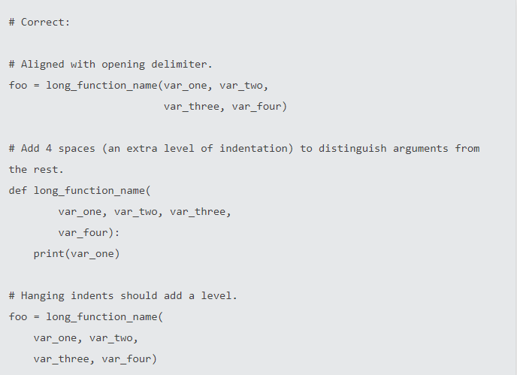
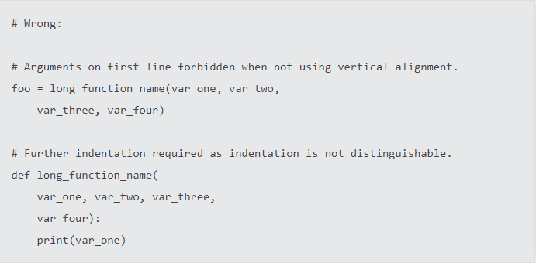
Indentation
Use 4 spaces per indentation level
Continuation lines should align wrapped elements either vertically using Python's implicit line joining inside parentheses, brackets and braces, or using a hanging indent. When using a hanging indent the following should be considered; there should be no arguments on the first line and further indentation should be used to clearly distinguish itself as a continuation line
怎么清晰怎么来

Slide 10
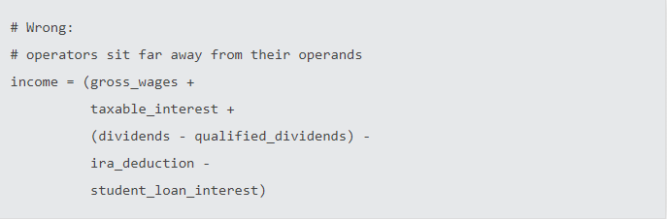
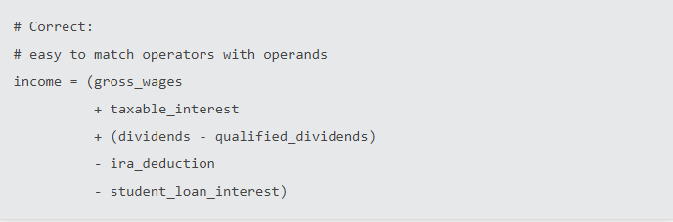
Binary Operator
Donald Knuth explains the traditional rule in his Computers and Typesetting series: "Although formulas within a paragraph always break after binary operations and relations, displayed formulas always break before binary operations"
怎么漂亮怎么来

Slide 11
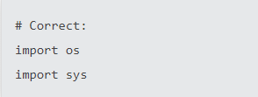


import
Imports are always put at the top of the file, just after any module comments and docstrings, and before module globals and constants.
Imports should be grouped in the following order:
Standard library imports.
Related third party imports.
Local application/library specific imports.
You should put a blank line between each group of imports.
Absolute imports are recommended, as they are usually more readable and tend to be better behaved
Wildcard imports (from <module> import *) should be avoided
怎么漂亮怎么来

Slide 12
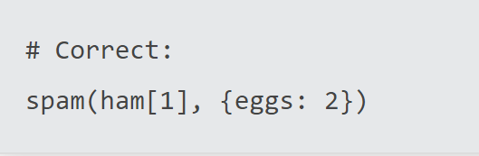
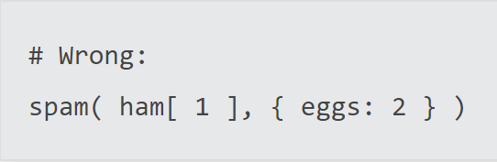
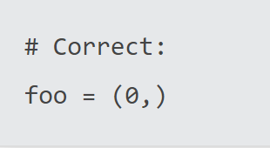
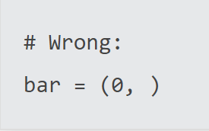
White Space: Pet Peeves
Avoid extraneous whitespace in the following situations:
Immediately inside parentheses, brackets or braces:
Between a trailing comma and a following close parenthesis:

Slide 13
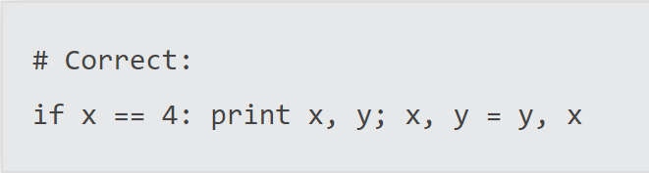
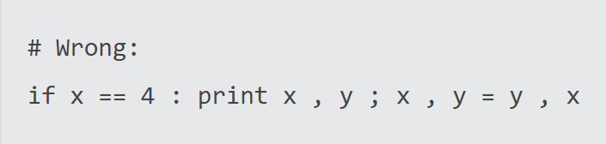
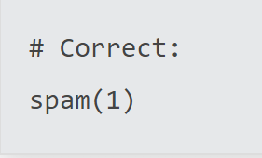
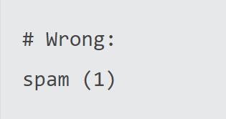
White Space: Pet Peeves
Avoid extraneous whitespace in the following situations:
Immediately before a comma, semicolon, or colon:
Immediately before the open parenthesis that starts the argument list of a function call:

Slide 14
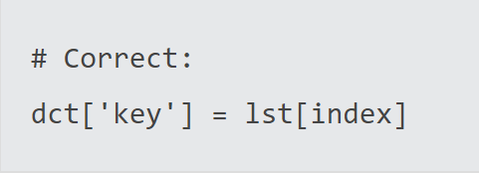
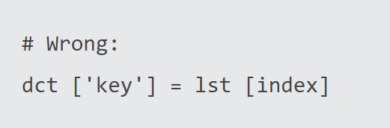
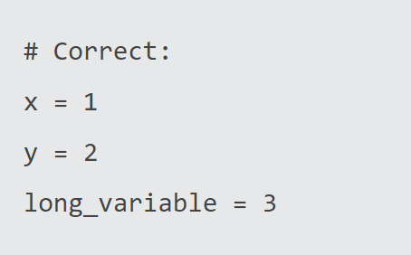
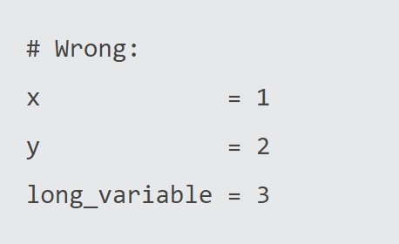
White Space: Pet Peeves
Avoid extraneous whitespace in the following situations:
Immediately before the open parenthesis that starts an indexing or slicing:
More than one space around an assignment (or other) operator to align it with another:

Slide 15
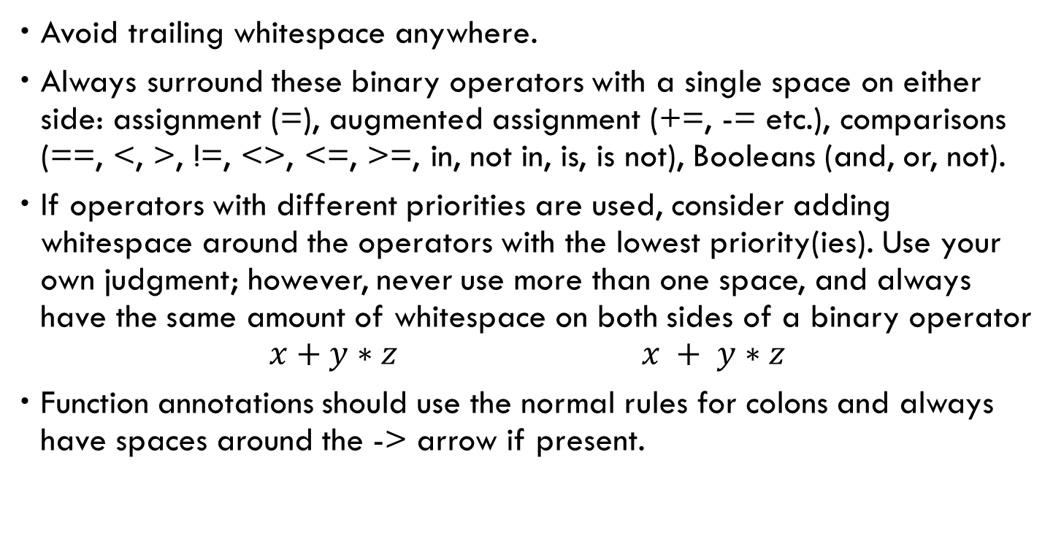
White Space: Recommendations
Avoid trailing whitespace anywhere.
Always surround these binary operators with a single space on either side: assignment (=), augmented assignment (+=, -= etc.), comparisons (==, <, >, !=, <>, <=, >=, in, not in, is, is not), Booleans (and, or, not).
If operators with different priorities are used, consider adding whitespace around the operators with the lowest priority(ies). Use your own judgment; however, never use more than one space, and always have the same amount of whitespace on both sides of a binary operator
$$x+y∗z x + y∗z$$
Function annotations should use the normal rules for colons and always have spaces around the -> arrow if present.

Slide 16
White Space: Recommendations
Don't use spaces around the = sign when used to indicate a keyword argument, or when used to indicate a default value for an unannotated function parameter
When combining an argument annotation with a default value, however, do use spaces around the = sign:
Compound statements (multiple statements on the same line) are generally discouraged
While sometimes it's okay to put an if/for/while with a small body on the same line, never do this for multi-clause statements. Also avoid folding such long lines!

Slide 17
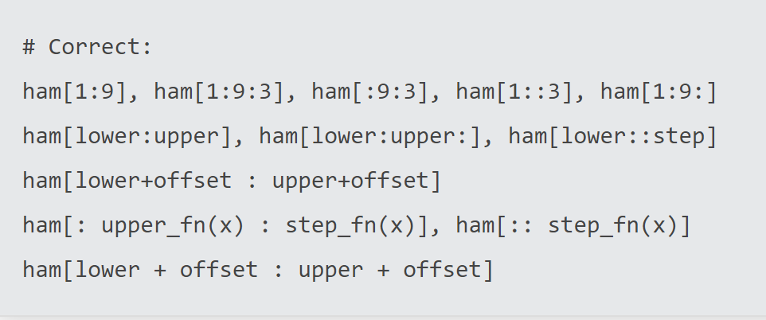
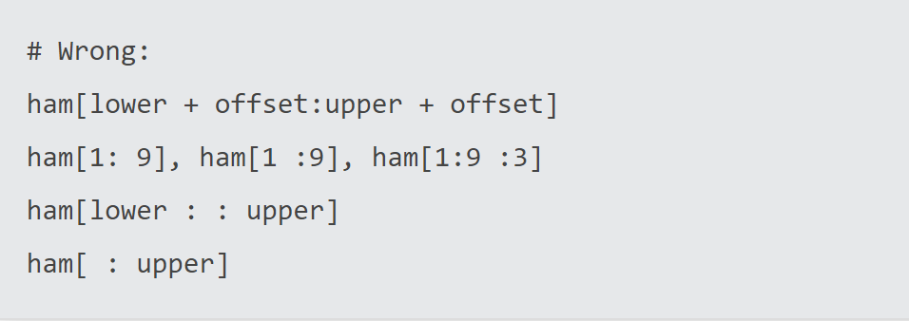
White Space: Summary
代码符合英文写作规划
用空格把程序切割成一个个合适的小的单元。每个单元有清晰的意思
风格要统一
不要挤成一坨
清晰最重要

Slide 18
Name Convention
无名天地之始，有名万物之母
Python命名: xxx_xxx_xxxxx
大小写区分规则：module_name, package_name, ClassName, method_name, ExceptionName, function_name, GLOBAL_CONSTANT_NAME, global_var_name, instance_var_name, function_parameter_name, local_var_name. CLASS_CONSTANT_NAME
Names to Avoid
Never use the characters 'l' (lowercase letter el), 'O' (uppercase letter oh), or 'I' (uppercase letter eye) as single character variable names.
In some fonts, these characters are indistinguishable from the numerals one and zero. When tempted to use 'l', use 'L' instead.
https://www.python.org/dev/peps/pep-0008/

Slide 19
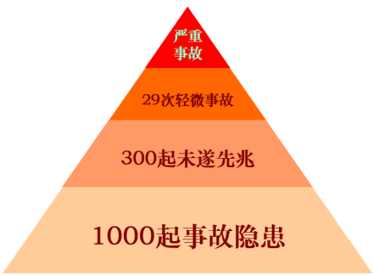
Warning and Fatal Error
安全生产：不带电操作
海恩法则，是航空界关于飞行安全的法则。
海恩法则指出: 每一起严重事故的背后，必然有29次轻微事故和300起未遂先兆以及1000起事故隐患。

Slide 20
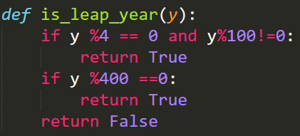
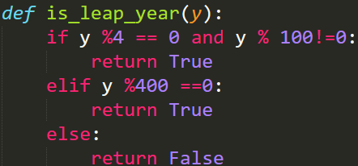
Leap year
A year is called leap:
It is divisible by 4 exactly
If it is divisible by 100, it should be divisible by 400
Write a function to implement it, try to simplify your code
精简：减少错误的可能

Slide 21
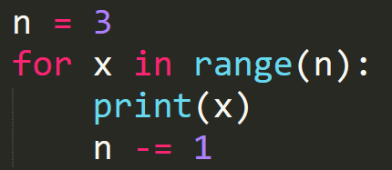

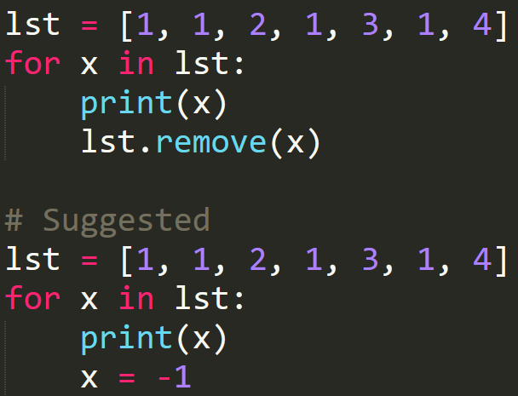


数据结构的遍历
特别小心：一边遍历数据结构，一边修改数据结构
从逻辑上面删除
使用copy

Slide 22
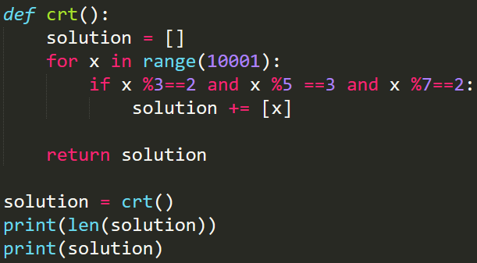
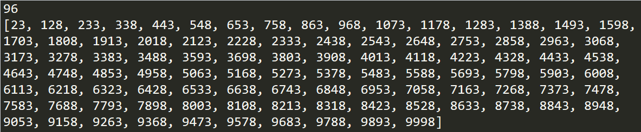
China Reminder Theorem(中国剩余定理)
今有物不知其数,三三数之剩二,五五数之剩三,七七数之剩二,问物几何?
三人同行七十稀,把除以3所得的余数用70乘.
五树梅花日一枝,把除以5所得的余数用21乘.
七子团圆正半月,把除以7所得的余数用15乘.
除百零五便得知
Please write a program to find all the solutions within 0 and 10000.

Slide 23
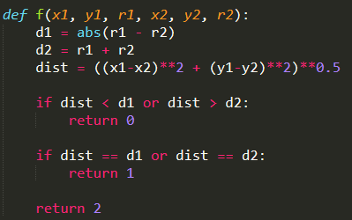
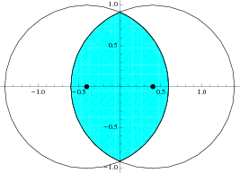
Intersection of two circles
Given the positions and radius, please find the number of intersections of two circles.
def f(x1, y1, r1, x2, y2, r2):

Slide 24
Max Consecutive Ones
Given a binary array, find the maximum number of consecutive 1s in this array.
Example 1:
Input: [1,1,0,1,1,1]
Output: 3
Explanation: The first two digits or the last three digits are consecutive 1s.
The maximum number of consecutive 1s is 3.
Note:
The input array will only contain 0 and 1.
The length of input array is a positive integer and will not exceed 10,000

Slide 25
Best Time to Buy and Sell Stock II
Say you have an array for which the ith element is the price of a given stock on day i.
Design an algorithm to find the maximum profit. You may complete as many transactions as you like (ie, buy one and sell one share of the stock multiple times). However, you may not engage in multiple transactions at the same time (ie, you must sell the stock before you buy again).

Slide 26
Longest Continuous Increasing Subsequence
Given an unsorted array of integers, find the length of longest continuous increasing subsequence.
Example 1:
Input: [1,3,5,4,7]
Output: 3
Explanation: The longest continuous increasing subsequence is [1,3,5], its length is 3.
Even though [1,3,5,7] is also an increasing subsequence, it's not a continuous one
where 5 and 7 are separated by 4.
Example 2:
Input: [2,2,2,2,2]
Output: 1
Explanation: The longest continuous increasing subsequence is [2], its length is 1.
Note: Length of the array will not exceed 10,000.

Slide 27

Hanoi
The Tower of Hanoi (汉诺塔) is a mathematical game or puzzle.
It consists of three rods and a number of disks of different sizes, which can slide onto any rod.
The puzzle starts with the disks in a neat stack in ascending order of size on one rod, the smallest at the top, thus making a conical shape.
The objective of the puzzle is to move the entire stack to another rod, obeying the following simple rules:
Only one disk can be moved at a time.
Each move consists of taking the upper disk from one of the stacks and placing it on top of another stack or on an empty rod.
No disk may be placed on top of a smaller disk
Give a solution to this problem.
假定，任务是从圆柱1，将圆盘经过圆柱2，全部移动到圆柱3。输出移动的过程。

Slide 28
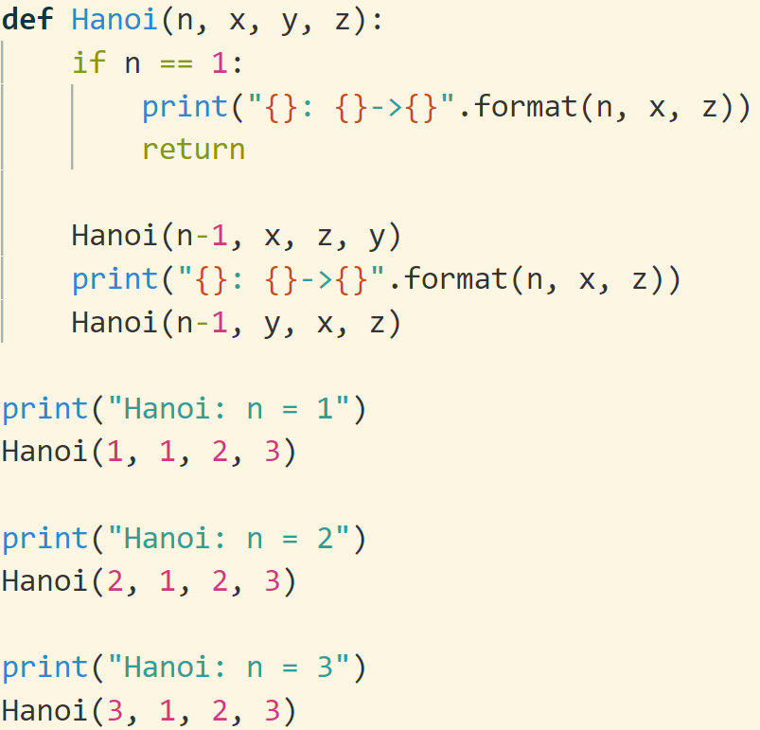
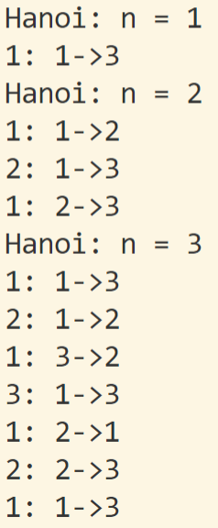
回顾：函数可以递归定义。但是函数调用时，即使函数名相同，参数不同也可以认为是不同的函数调用。
为方便理解，Hanoi(n-1, x, z, y)可以等价看成函数f(n-1) ； Hanoi(n-1, y, x, z)可以等价看成函数g(n-1)

Slide 29
N=1
print

Slide 30
N=2
N=1
N=1
print
print
print

Slide 31
N=3
N=2
N=1
N=1
N=2
N=1
print
print
print
N=1
print
print
print
print

Slide 32
递归函数
函数：一段具有某种功能的代码。
函数执行结束，表示着已经完成了函数所定义的功能。
递归函数：
1. 自己调用自己 ：从一个参数状态到另一个参数状态的转移 (状态转移)
2. 初始状态结束递归 (保证不会死循环)
3. 一个函数调用由 函数名+参数 决定，参数不同、函数名相同也是不同的调用
功能可以是：
函数值，譬如gcd (简单，好理解)
抽象的一组事件。譬如Hanoi (抽象，要仔细分析)
有问题？？？从定义出发思考
函数：一段具有某种功能的代码。函数执行结束，表示着已经完成了函数所定义的功能。

Slide 33
以函数Hanoi(n, x, y, z)为例：
定义功能：输出将n个盘子从x途经y搬到z的过程 (学习体会！)
由于Hanoi中每个小盘子只能放到大盘子上
首先要把盘子n，从x搬到z。必须先将1-(n-1)号盘子先搬到中间点y。
Hanoi(n-1, x, z, y) # 调用函数 n-1, x, z, y。函数结束运行后，表明已经完成了定义的功能（即输出了所有的步骤！细细体会！！）
然后将n号盘子从x搬到z。
最后一步，我们需要将1-(n-1)号盘子从y搬到z，递归调用即可
Hanoi(n-1, y, x, z)#调用函数 n-1, x, z, y。函数结束运行后，表明已经完成了定义的功能（即输出了所有的步骤！细细体会！！）
def Hanoi(n, x, y, z):
if n == 1: # 确保函数会结束递归
print("{}: {}->{}".format(n, x, z))
return
#下面三个函数调用完整地实现了Hanoi既定的功能
Hanoi(n-1, x, z, y)
print("{}: {}->{}".format(n, x, z))
Hanoi(n-1, y, x, z)

Slide 34
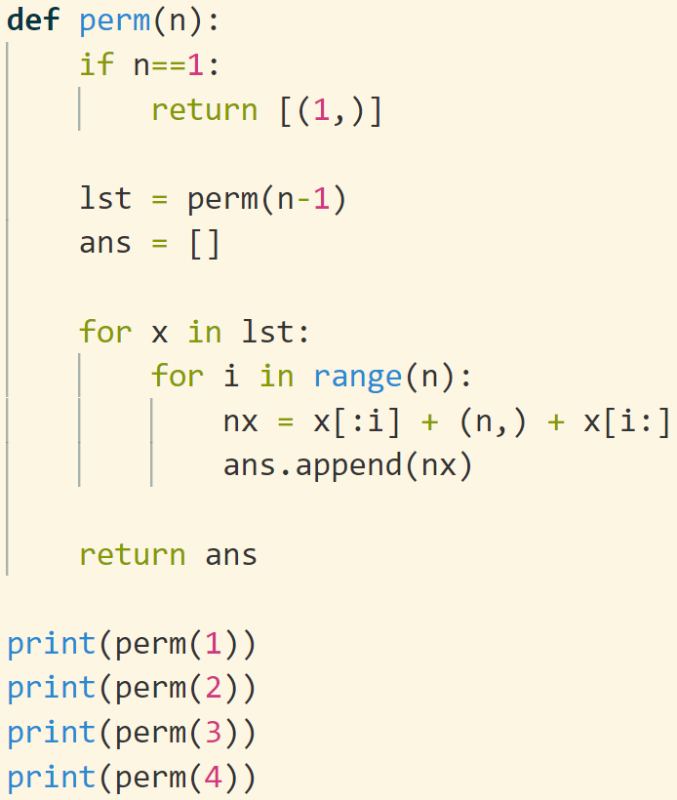
permutation
问题：生成1,…,n的所有排列
问题具有递归的特点：1-n可以由1-(n-1)插入n得到
函数定义 def perm(n): # return list： 每个元素是1-n的一个排列 [[],[],[],…]
扩展问题
有序排列
n选r排列
n选r组合

Slide 35
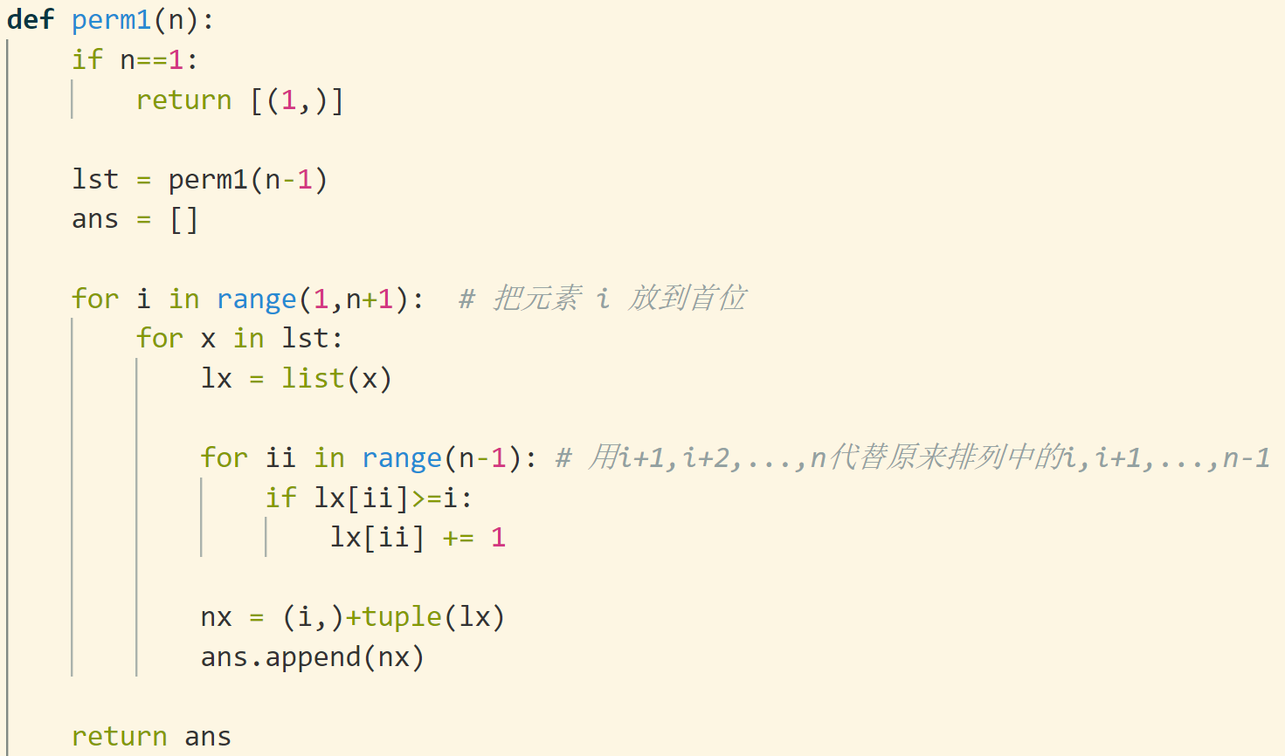
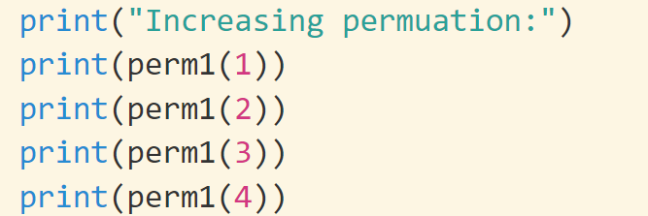

Slide 36
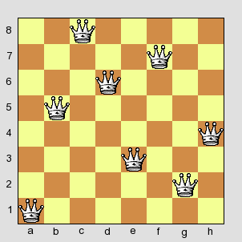
Eight Queens
Find the number of solutions for 8 Queens problem
How to check whether a given solution is valid
How to generate all the possible solutions
Ans: 92
How to represent a solution?

Slide 37
